Slide 1

“Mommy, where do scientific journal articles come from?”
FISH 290
Thursday

Slide 2
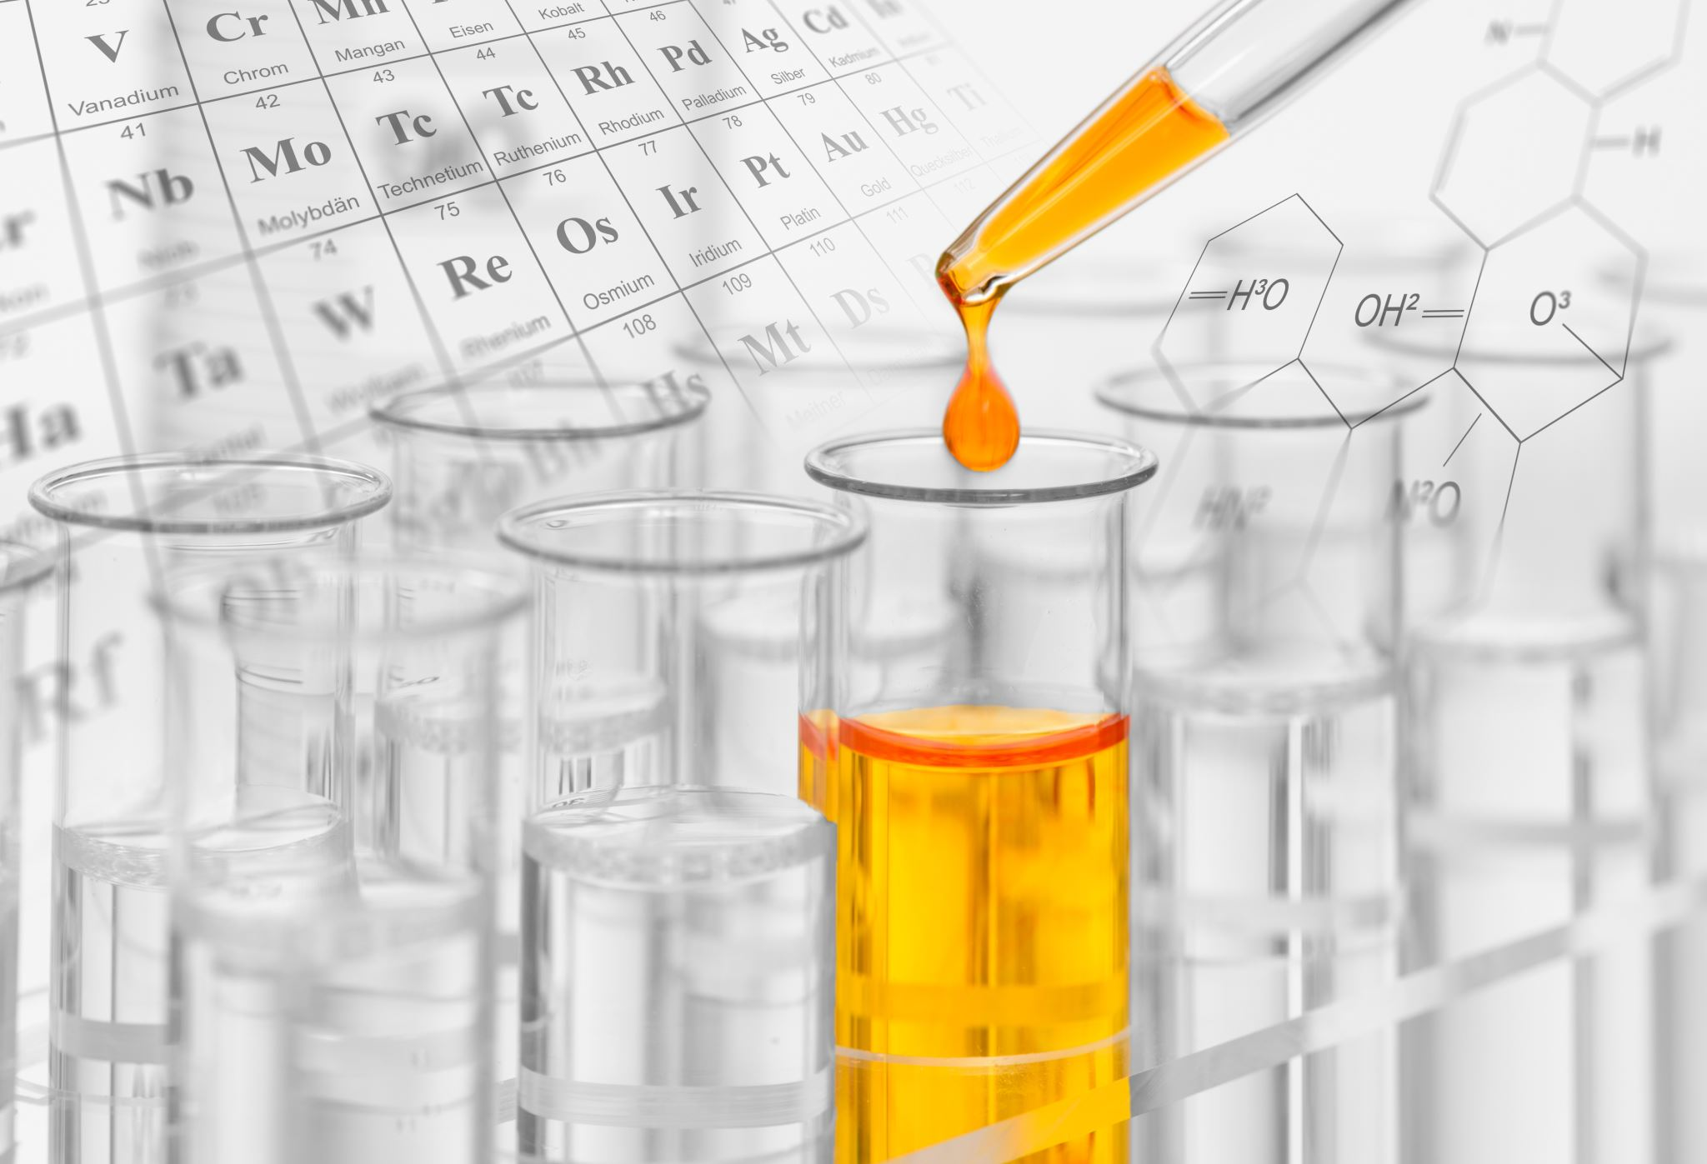
The “classic” scientific method:
Pose a null and one or more alternative hypotheses
Conduct an experiment and record the data
Examine the data with statistical techniques
Reject the null hypothesis (with some risk of error),
Or, be unable to reject the null hypothesis and so have to accept it as correct (with some risk of error).

Slide 3
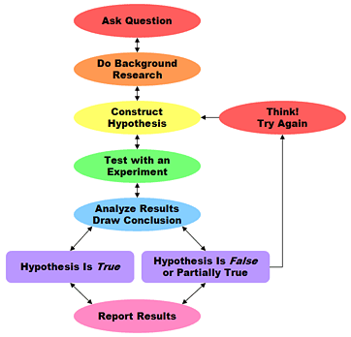
http://www.sciencebuddies.org/science-fair-projects/project_scientific_method.shtml
Steps of the scientific method

Slide 4
Ask a question:
For the scientific method to answer the question it must be about something that you can test, preferably something that you can quantify (measure, count, etc.).
Do background research: Rather than starting from scratch in putting together a plan for answering your question, you’ll want to do a library/internet/interview search to help you find the best way to do things and ensure that you aren’t repeating what’s already been done.
http://www.sciencebuddies.org/science-fair-projects/project_scientific_method.shtml

Slide 5
Construct a hypothesis: A hypothesis is an educated guess about how things work:
“If _____[I do this] _____, then _____[this]_____ will happen.”
“If _[some theory or idea]____ is true, then we should expect to see __[data or action]______.”
You must state your hypothesis in a way that you can easily measure and, of course, your hypothesis should be constructed in a way to help you answer your original question.

Slide 6
Test your hypothesis by doing an experiment
Experiments have two essential features:
Treatment and control
Replication

Slide 7
What about other forms of analysis and inference?
Do we always need to be explicitly erecting and falsifying hypotheses?
We might want to estimate the relative effect of different processes on some complex outcome, rather than narrowly determining whether each, in isolation, has an effect or not.
We might want to estimate the relative likelihood of a series of possible outcomes, rather than just stating which is the most likely to occur.
The scientific process is as diverse as the people practicing science.

Slide 8
Approaches that do not involve direct experimentation?
Observation (animal behavior, environmental change, etc.)
Correlation (density and growth, salinity and survival, etc.)
Modeling (using the computer to explore scenarios, options)
Morphology (paleontology, etc.)
Descriptive (discovery of a new species of organism)
Microscopical examination (new pathogens, structures, etc.)
Others
Are null hypotheses imbedded in these non-experimental studies?

Slide 9
Communicate your results: To complete your project you communicate your results to others.
presenting your findings orally at a scientific meeting
a poster at a scientific meeting
publishing the work in a scientific journal
Publishing results in popular media

Slide 10

Where do we find scientific information?
Peer-reviewed journals
Single-authored books
Edited, multi-authored books
Master’s theses and doctoral dissertations
Agency reports (sometimes called “grey literature”)
Websites and other electronic sources
Others?
Each form of communication has strengths and weaknesses; it is important to understand their differences.

Slide 11

Types of scientific literature
Primary: represents the results of an original study
Scientific papers in IMRaD format*
*note that some journals like Science and Nature use a different format more like a magazine article
Also includes conference papers, dissertations, and technical reports
How do you know you’re reading primary literature? Look for (mention of) Methods and Results.

Slide 12
Types of scientific literature
Primary: represents the results of an original study
Not all primary literature is peer-reviewed.
Grey literature refers to reports that are archived but have not been peer-reviewed. Include dissertations, technical reports, and pre-prints

Slide 13
Types of scientific literature
Secondary: sources based on multiple primary literature sources
Books
Popular articles
Review papers in scientific journals. Review papers are peer reviewed!
Great for readers to get an overview on a topic
Sometimes contain new insights based on surveying the literature

Slide 14
How is science published?
Choose a journal to submit your manuscript
Often you write the draft of the manuscript with this journal in mind far in advance
Each journal has specific formatting requirements you must follow
Submit the manuscript online
An editor sends the manuscript out to anonymous peer reviewers
Who are peer reviewers and how are they chosen?
Reviews come back and the editor makes a decision
Usually five options: Accept-as-is, Minor revisions, Major revisions, Reject + resubmit, or Reject without option to resubmit
Manuscript is accepted to the journal!
Journal staff type-set the article and it is published (usually a month or more after acceptance)

Slide 15
The Scientific Method
The Question
The Study
The Manuscript
REJECT
Response FROM Editor
External Review
Submit to Journal
ACCEPT
RESUBMIT
Response TO Editor
Manuscript
Accepted
Manuscript
Published

Slide 16
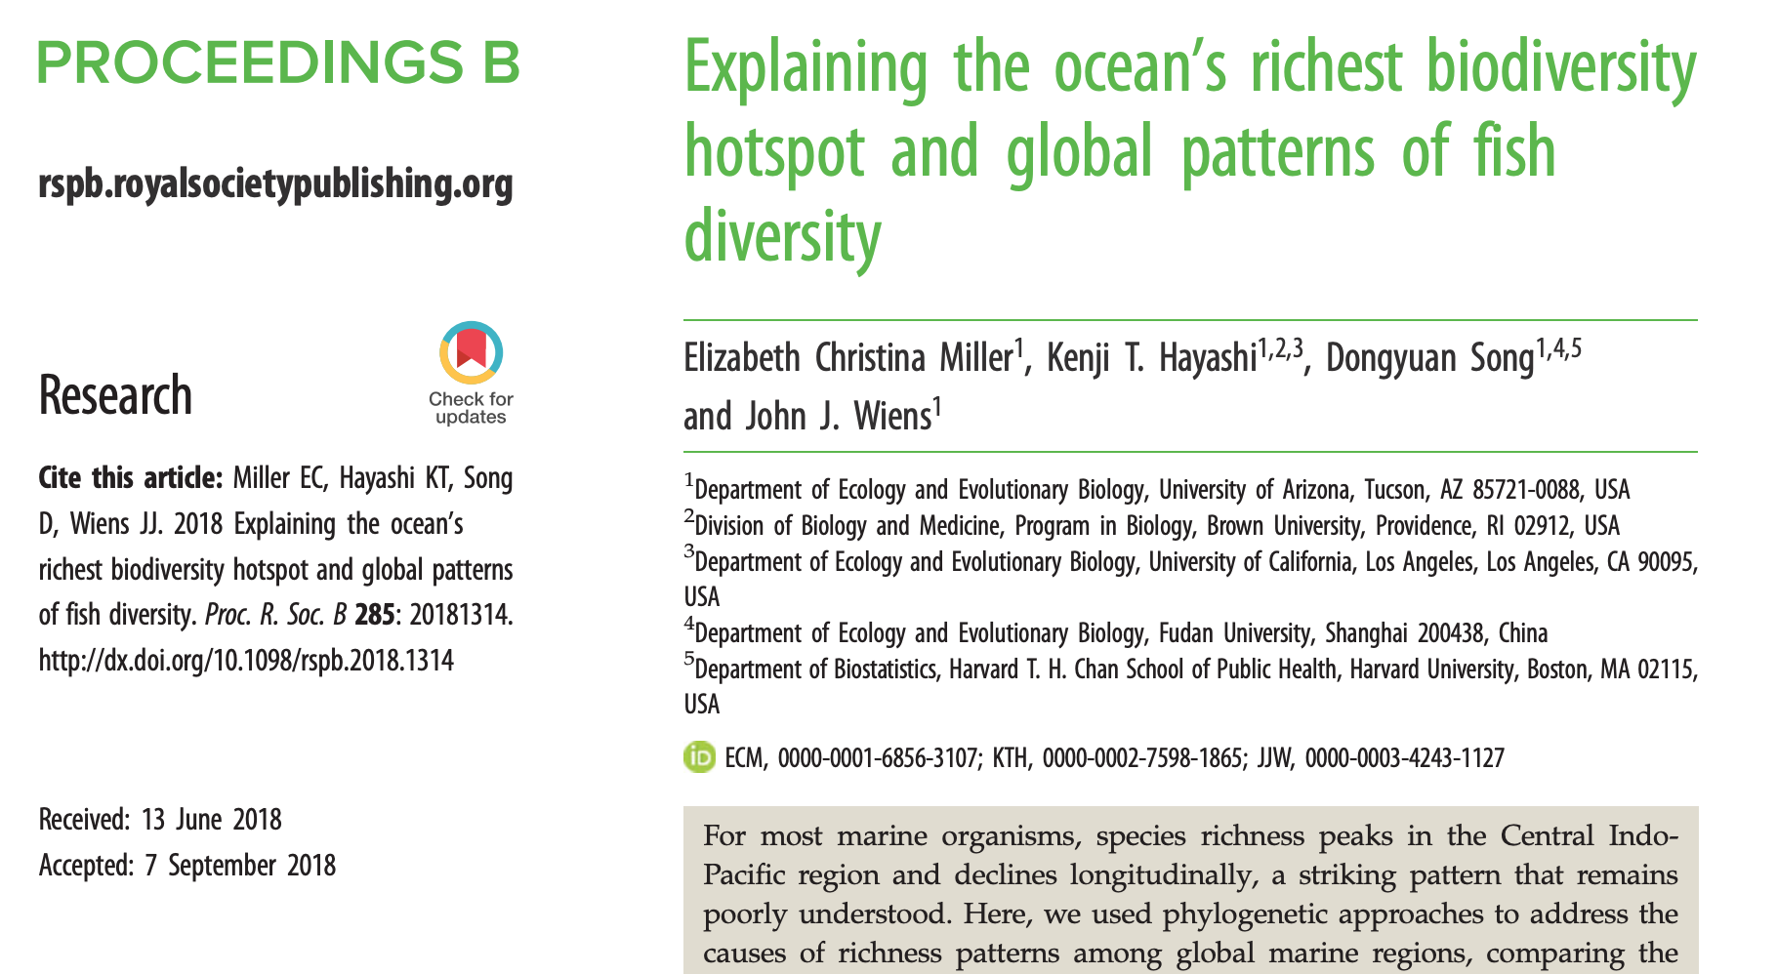
How is science published?
An example from my post-doc’s experience:

Slide 17
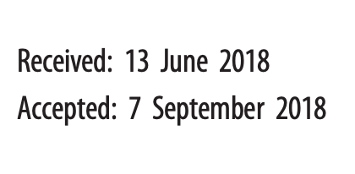
How is science published?
An example from my post-doc’s experience:

Slide 18
How is science published?
An example from my post-doc’s experience:
Lessons:
Publishing takes a long time
Rejection is the NORM!
(cue 5 stages of grief)
Behind the scenes, it took 1 year from final draft to published paper
October 2017: finished the “final” draft, submit PNAS
November 2017: PNAS reject, reformat + submit PLoS Biology.
2 days later PLoS Biol reject, reformat + submit to Proc. B
March 2018: Decision: Reject + resubmit
June 2018: revisions done, sent back to Proc B
August 2018: Decision: Minor revisions
September 2018: revisions done, sent back to Proc B
September 2018: Accept as-is
October 2018: Paper comes out in journal

Slide 19
How is science published?
An example from my experience:
“Final draft” submitted to Systematic Biology – summer 2014
3 rejections in 3 different journals
2 additional rounds of revision in Molecular Phylogenetics and Evolution
Finally published in 2018

Slide 20
Scientific journals and articles:
So much to read; so little time.
So, what are we looking for?

Slide 21
Class activity 1:
We will look at the names of selected journals and you will indicate whether you would regard them as
likely to read
might read if I had time
not likely to read
Remember, we are all busy and no one can read everything. There are 12 journals, so you must choose 4 to read, 4 “maybes” and 4 that you’d skip.

Slide 22
Would you read this journal:
Journal title Yes Maybe Not Likely
Marine Biology
Freshwater Biology
Animal Behaviour
Ecological Modeling
Ecology
Molecular Ecology
Journal of Fish Biology
Journal of Crustacean Biology
Journal of Fish Diseases
Science
Canadian Journal of Zoology
Canadian Journal of Fisheries
and Aquatic Sciences

Slide 23
Let’s hear your ideas!
Let’s narrow down your ideas into a question and a set of testable hypotheses

Slide 24
Project titles from last quarter (and where they found their data)
Analysis of Invasive European Green Crab Diet and Impact on Atlantic Ocean Ecosystems – Several unique peer reviewed studies combined
Niche Partitioning of Jellyfish in the Puget Sound – dataset from Luke
Change in Freshwater Fish Aggression from Increased Temperature - Several unique peer reviewed studies
Small body size as a contributing factor of symbiosis in Gobies and Wrasses– literature review, Fishbase for body size
Fisheries Management Plan effects on Horseshoe crabs – NOAA
Habitat Partitioning in Puget Sound Flatfishes – WDFD commercial fishing data
Human population density impacts on freshwater macroinvertebrates - King County Benthic Macroinvertebrate Ambient Monitoring Program
Comparing PCBs in Puget Sound Fishes – WDFW/Luke
Top down vs Bottom up population control in three North Atlantic fishes - NOAA

Slide 25
Project titles from previous quarters (and where they found their data)
Infection Rate Factors of Stony Coral Tissue Loss Disease in the Florida Keys and Caribbean- NOAA
Effects of Abiotic Factors on the Foraging Behavior of Enhydra lutra- WA state monitoring data
Mercury Content of Puget Sound Rockfish- Puget Sound Ambient Monitoring Program
Impact of Volcanic Activity on Phytoplankton Blooms in the Bering Sea- combo of Alaskan Volcanic Observatory and NOAA data
Effects of physical water conditions on Neocaridina invasions in the rivers of Hiroshima Prefecture- data from a peer-reviewed study

Slide 26
Project titles from previous quarters(and where they found their data)
Decoding the Population Decline of Dungeness Crab, C. magister, in South Puget Sound- WA Dept Fish and Wildlife
Effects of Skagit River discharge on steelhead smolt outmigration- combo USGS and WDFW
Relative Brain Size and Other Factors Contributing to Cetacean Extinction- combo IUCN and data from a peer-reviewed study
East and West Coast Analysis of the Effectiveness of Marine Protected Areas- data from peer-reviewed studies
Effect of Procambarus clarkii on Abundance of Trichopterans and Diversity of Macroinvertebrates in Pine Lake, Washington- Puget Sound Benthos Survey

Slide 27
For Tuesday
Continue thinking about your question and make it more focused. After thinking about sources of data and potential limitations, write down your more focused question and hypotheses and be prepared to share next class.

